Slide 1

Transitioning Top Tips
Panel Discussion

Slide 2
Agenda
5 mins: Introduction of Panelists
20 mins: Facilitated Q&A
5 mins: Q&A from audience

Slide 3
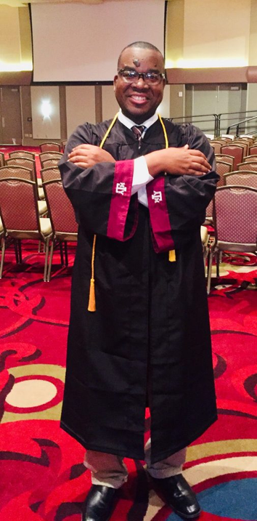
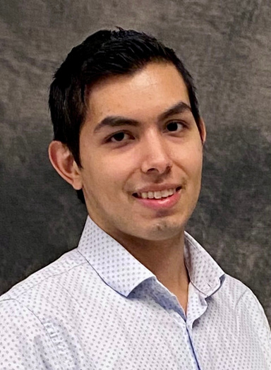
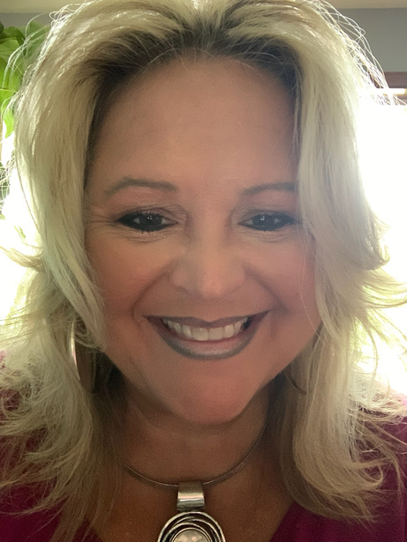
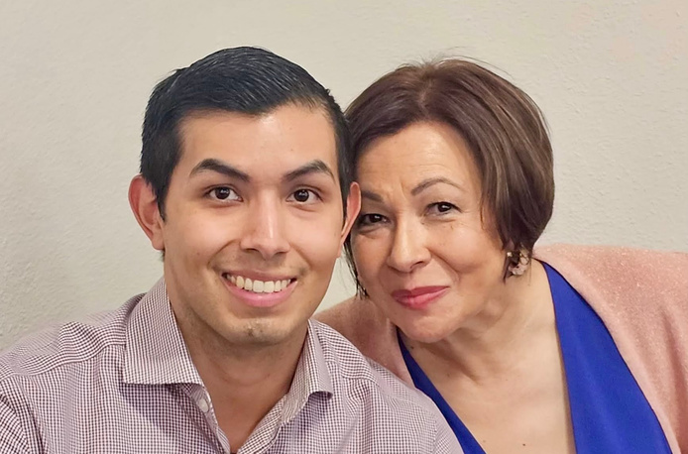
Panelists
Jana Palcer
Eric Shahid
Ernesto C Chacon
Parent Advocate
Self-Advocate, Founder of Shahid Center for Ability and Development
Self-Advocate,
Health Inspector for Galveston County Health District
Amparo Chacon
Mrs. Shahid
Parent Advocate
Parent Advocate

Slide 4



When did you start transition planning? When do you wish you would have started?
Self-Advocate

Slide 5
School support
School Support:
What resources or strategies helped foster independence skills?
Parents

Slide 6
What routines/activities did you do with your child to promote independence?
Parents

Slide 7

When routines did you implement to encourage independence skills?
Parents

Slide 8

My first year out of school, I needed the most help with...
Self-advocate

Slide 9
What has been your biggest success?
Self-advocate

Slide 10
Q&A
Questions from the audience

