Slide 1
Essential Skills for Successful Long-term Employment
Brazos Valley Disability Conference 2024

Slide 2
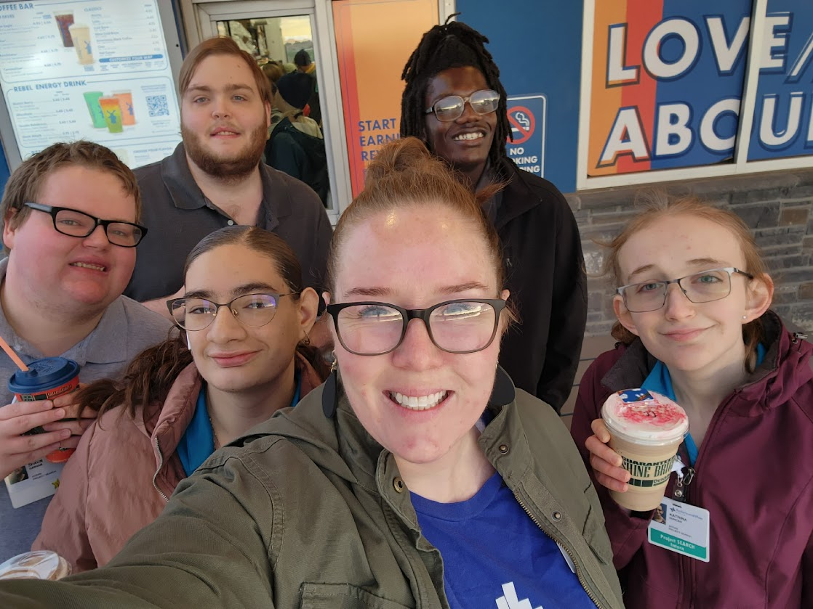
About Me
Beth Sherry
CSISD Project SEARCH Instructor
esherry@csisd.org

Slide 3
Getting the Job
Job Search Process
Applications
Interview & Follow-Up

Slide 4
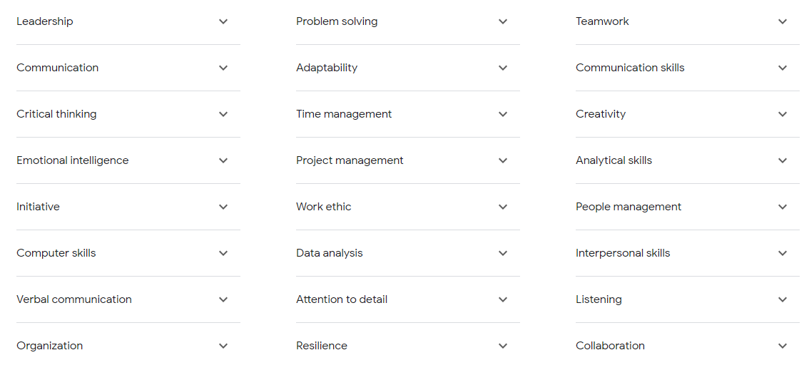
Tops Skills Employers Look For:
Based on Google Search for “Top Skills Employer Look For” - compiled by Google from sources across the web

Slide 5
How To Develop These Skills
Leadership
Communication
Critical Thinking
Emotional Intelligence - Handling/expressing Frustration, Coping with/managing emotions
Initiative + Finding tasks to stay busy - asking what’s next
Computer Skills - navigating email,
Organization

Slide 6
How To Develop These Skills ..
Problem Solving
Adaptability
Time Management
Work Ethic
Attention to Detail
Resilience & Persistence

Slide 7
How To Develop These Skills …
Teamwork/Collaboration
Creativity
Analytical Skills
Interpersonal Skills
Active Listening

Slide 8
Unwritten Skills That Are Expected:
Consistent attendance, being on time
Appropriate phone use
Accepting Feedback
Asking for Help & Clarification
Advocating for needs

Slide 9
What Can You Do Now?
Set routines
Encourage Independence - I do, we do, you do with fading support
Teach problem-solving skills - allow struggle & support through it, model your thought process
Independence Skills - Checklist

Slide 10
Support, Resources, & Programs
Texas Workforce Commission - Vocational Rehabilitation Services
Brazos Valley Center for Independent Living
Transition Coordinators for CSISD & BISD
18+ Programs Available Through Your District - Project SEARCH (CSISD & BISD), BRIDGES (CSISD)
WACO Project, Summer Earn & Learn, PATHS Program,
Essential Skills for Successful Long-term Employment Resource Website

