Slide 1
Oh the Places You Will Go: Fostering Strength, Confidence and Creativity with Disabled Youth and Young Adults
Justin Romack

Slide 2
Oh the Places you will go
Notes:
Congratulations!
Today is your day.
You're off to Great Places!
You're off and away!
You have brains in your head.
You have feet in your shoes.
You can steer yourself
any direction you choose.
You're on your own. And you know what you know.
And YOU are the guy who'll decide where to go.

Slide 3
On today’s agenda:
Meet Justin
Phases of transition
Reflection and takeaways
Putting it all together

Slide 4
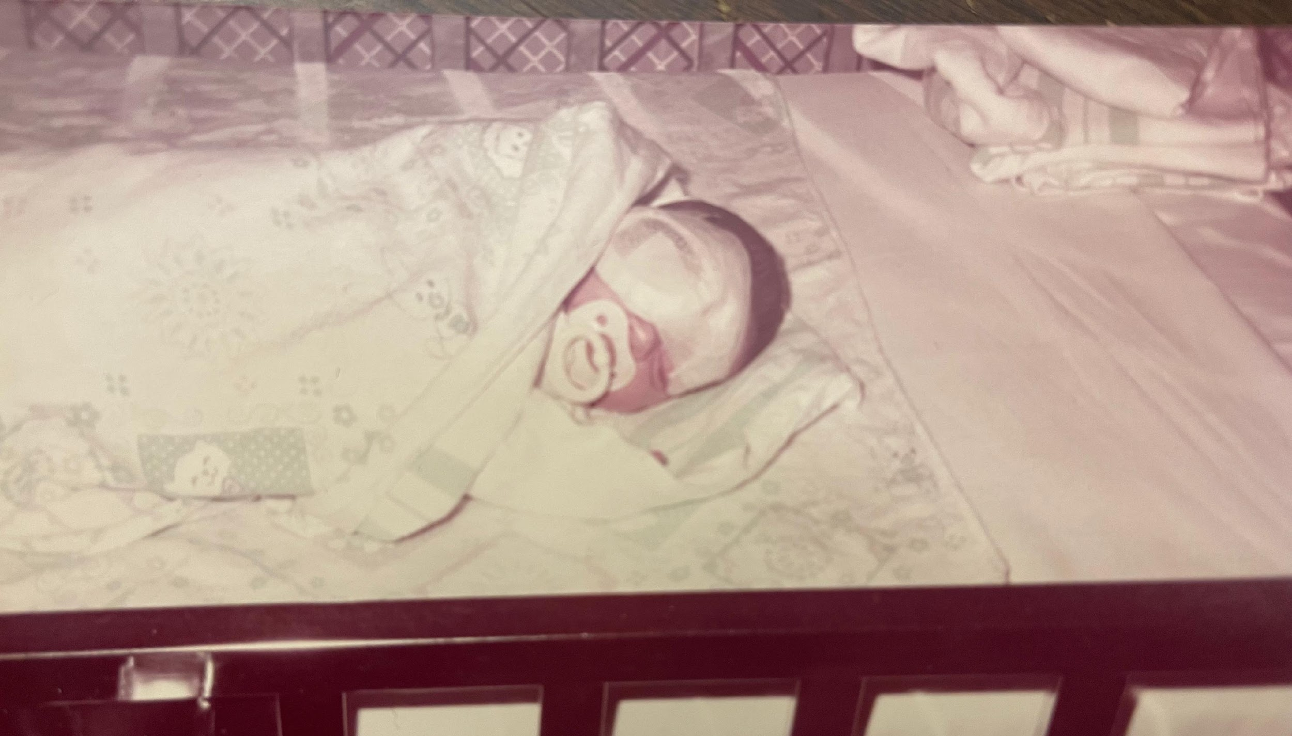
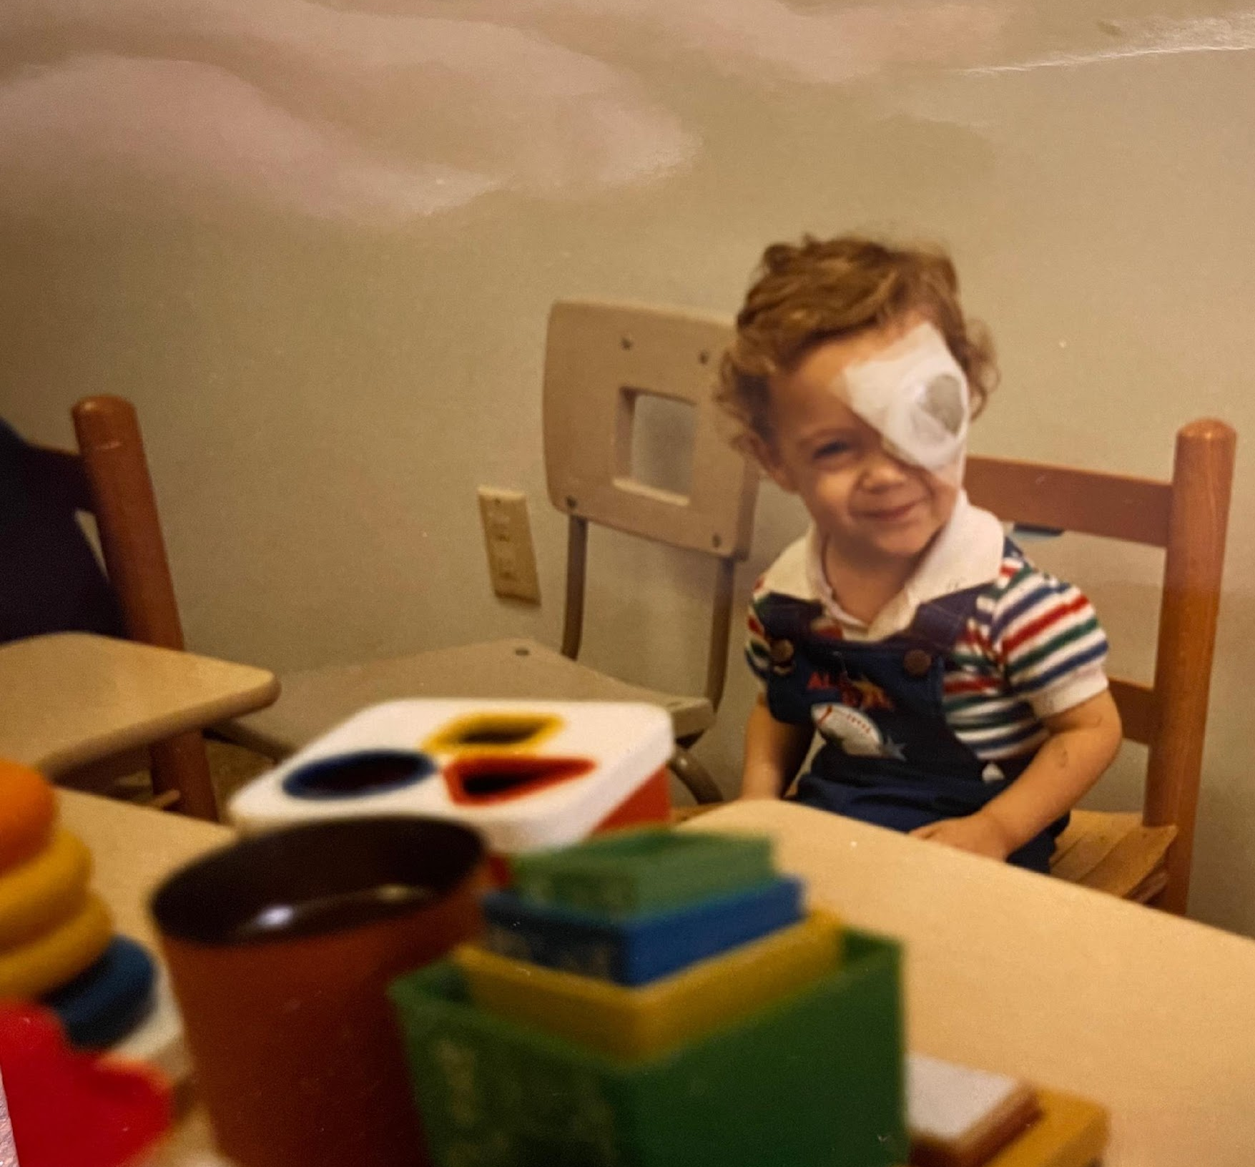
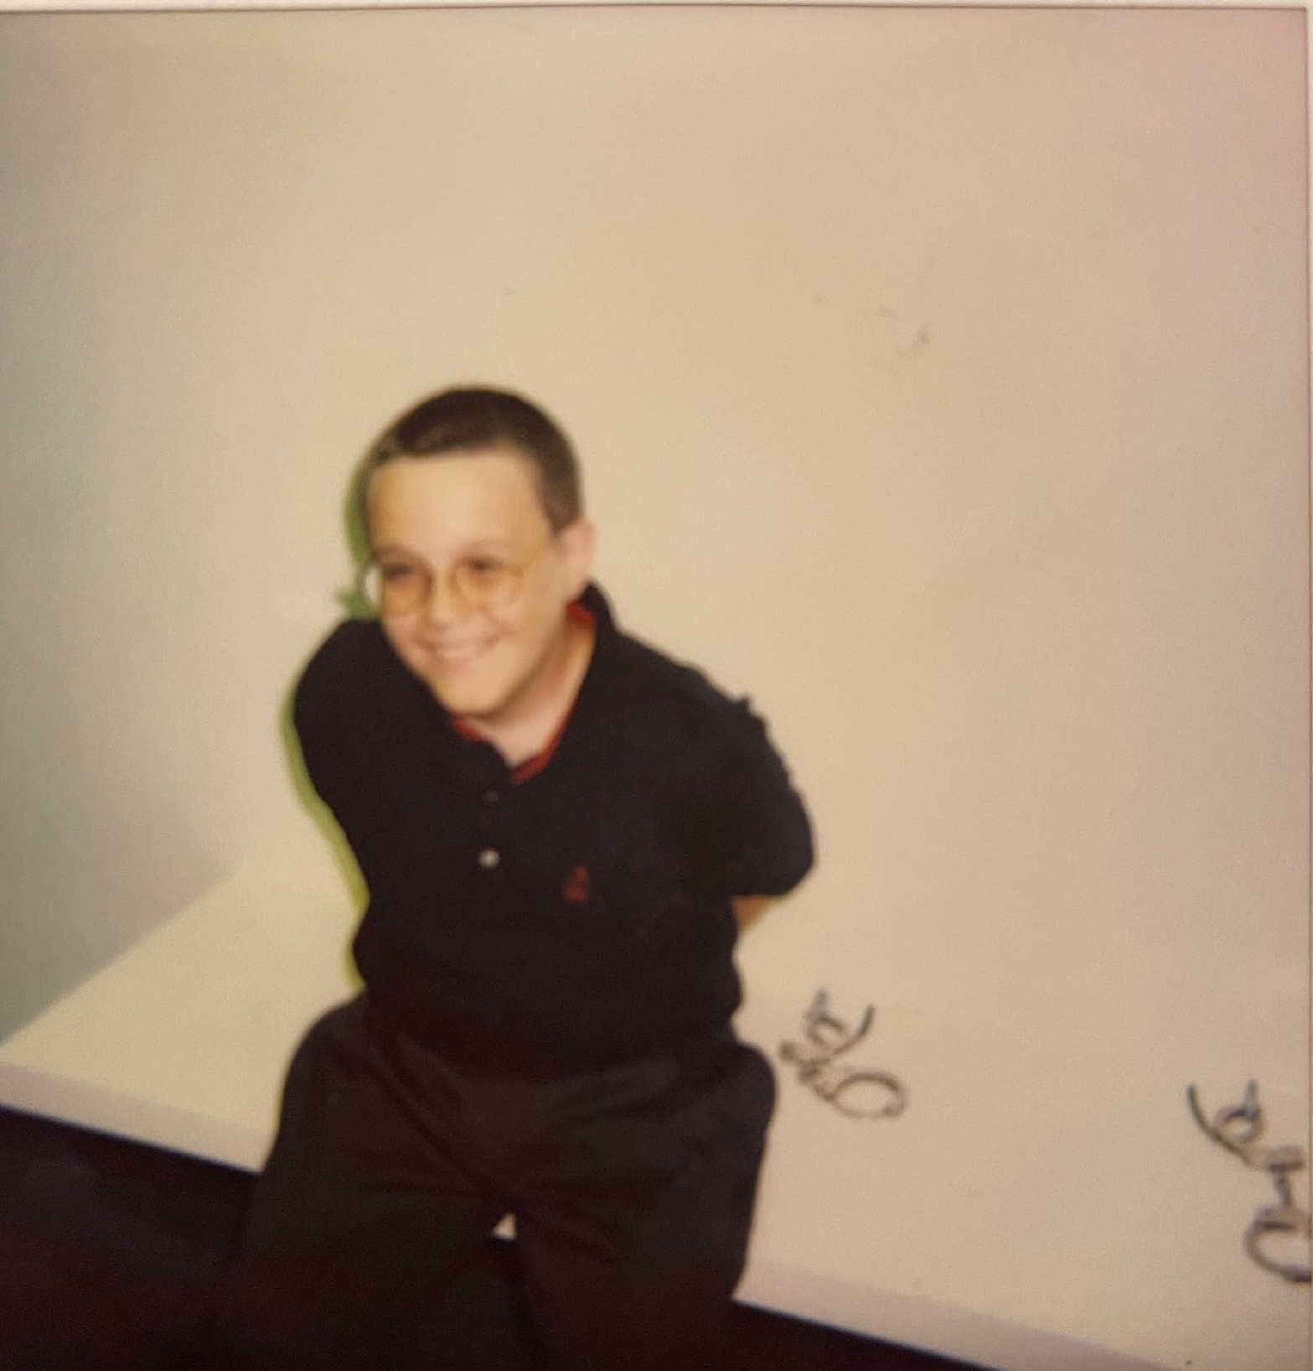
Meet Justin

Slide 5
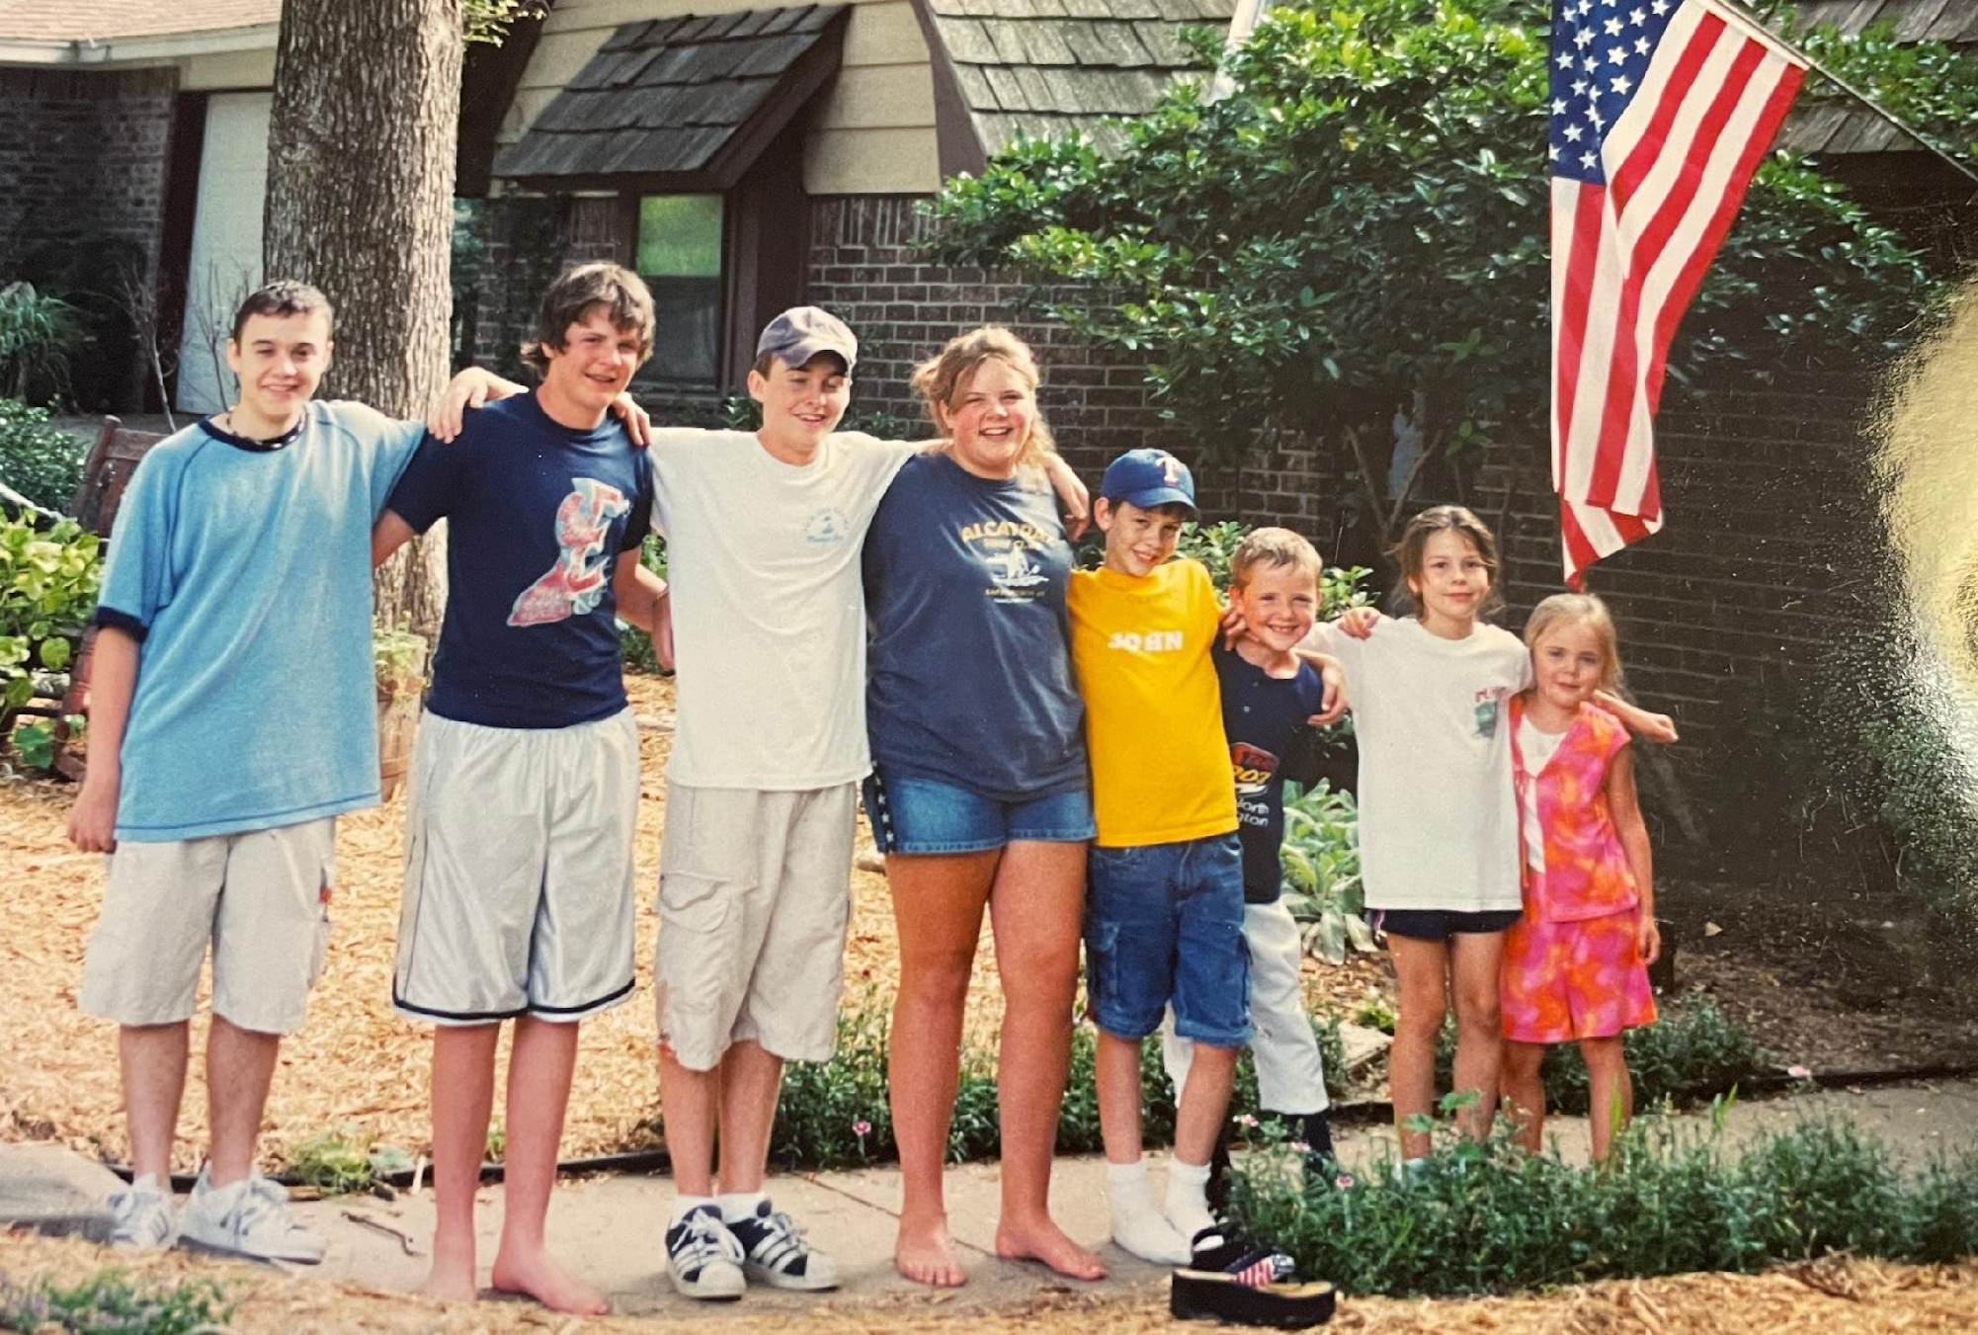
Growing up and approaching transition

Slide 6
I don’t choose to go there
Notes:
You'll look up and down streets. Look 'em over with care.
About some you will say, "I don't choose to go there."
With your head full of brains and your shoes full of feet,
you're too smart to go down any not-so-good street.
And you may not find any
you'll want to go down.
In that case, of course,
you'll head straight out of town.
It's opener there
in the wide open air.
Out there things can happen
and frequently do
to people as brainy
and footsy as you.
And then things start to happen,
don't worry. Don't stew.
Just go right along.
You'll start happening too.

Slide 7
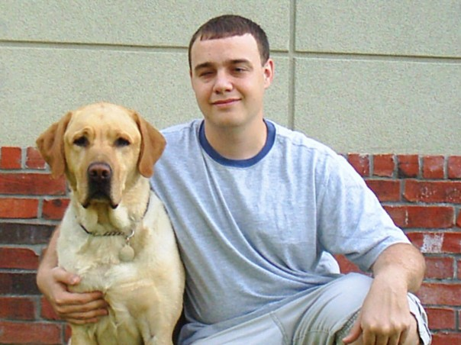
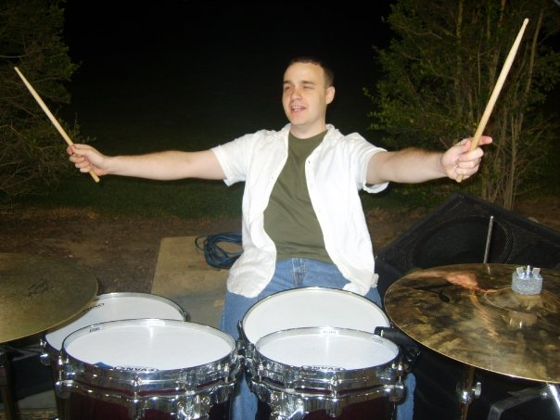
Transitioning to college and adulthood

Slide 8
Capable and confident aren’t mutually exclusive

Slide 9
Opportunities, reflections, and meaning-making

Slide 10
Choose your own adventure

Slide 11
Transition doesn’t happen on a conveyer belt

Slide 12
FUN
Notes:
Oh, the places you'll go! There is fun to be done!
There are points to be scored. There are games to be won.
And the magical things you can do with that ball
will make you the winning-est winner of all.
Fame! You'll be as famous as famous can be,
with the whole wide world watching you win on TV.
Except when they don't
Because, sometimes they won't.
I'm afraid that some times
you'll play lonely games too.
Games you can't win
'cause you'll play against you.
All Alone!
Whether you like it or not,
Alone will be something
you'll be quite a lot.
And when you're alone, there's a very good chance
you'll meet things that scare you right out of your pants.
There are some, down the road between hither and yon,
that can scare you so much you won't want to go on.
But on you will go
though the weather be foul.
On you will go
though your enemies prowl.
On you will go
though the Hakken-Kraks howl.
Onward up many
a frightening creek,
though your arms may get sore
and your sneakers may leak.
On and on you will hike,
And I know you'll hike far
and face up to your problems
whatever they are.

Slide 13
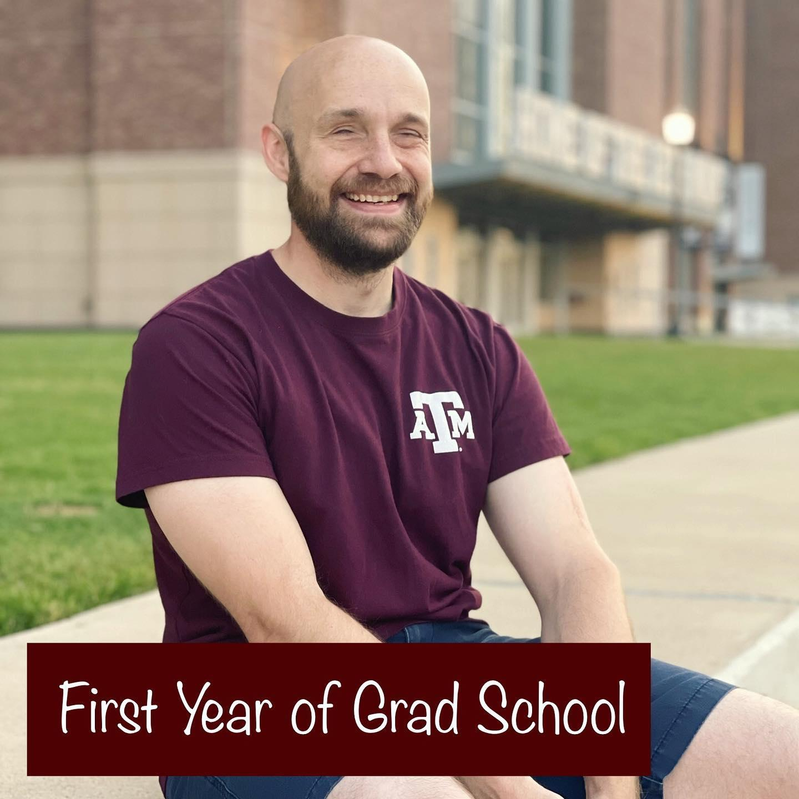
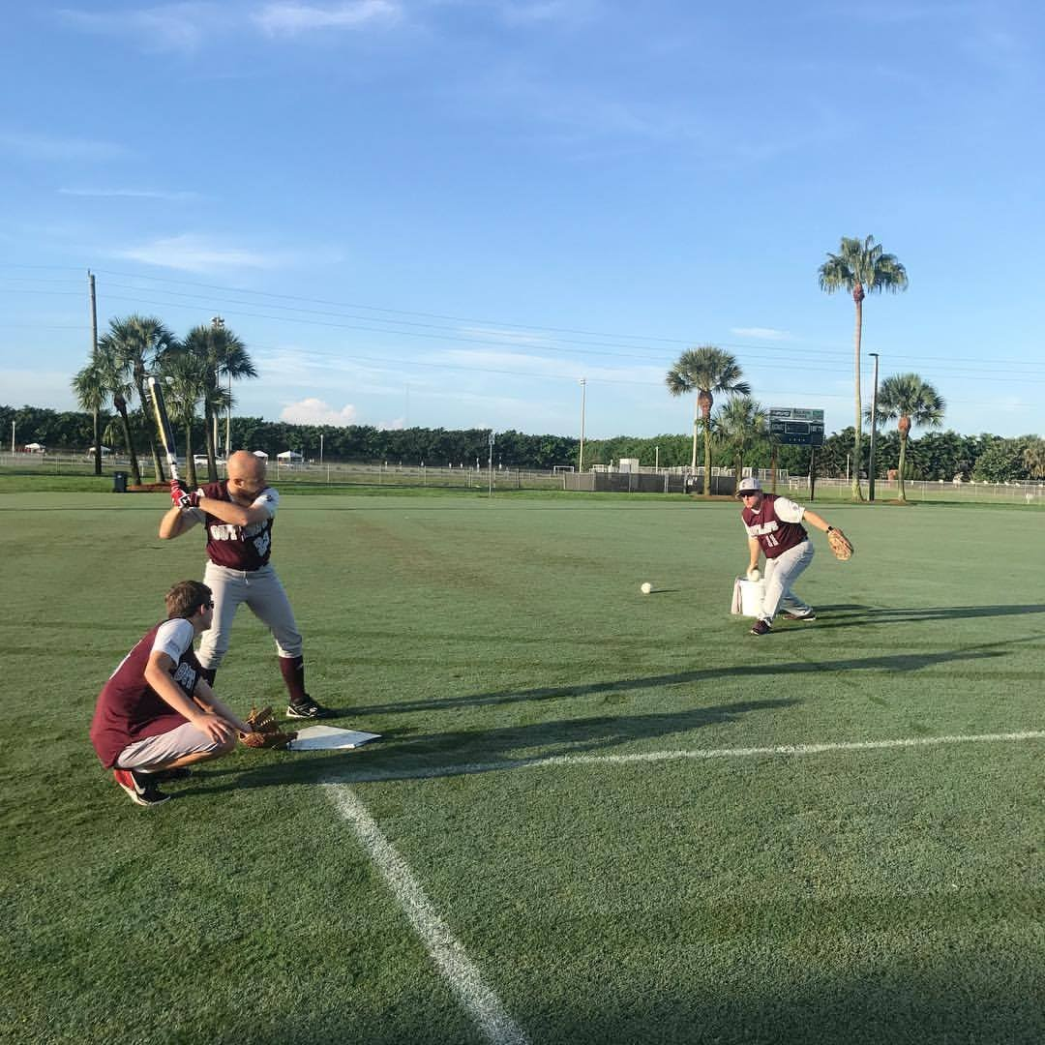
Where am I today?

Slide 14
Taking a pulse on today’s students

Slide 15
Balancing self-advocacy and help-seeking

Slide 16
Understanding the tools in their toolbox

Slide 17
Knowing how to pivot

Slide 18
Owning their identity

Slide 19
Putting it all together

Slide 20
A Great Balancing Act
Notes:
So be sure when you step.
Step with care and great tact
and remember that Life's
a Great Balancing Act.
Just never forget to be dexterous and deft.
And never mix up your right foot with your left.
And will you succeed?
Yes! You will, indeed!
(98 and 3/4 percent guaranteed.)
KID, YOU'LL MOVE MOUNTAINS!
So...
be your name Buxbaum or Bixby or Bray
or Mordecai Ali Van Allen O'Shea,
You're off the Great Places!
Today is your day!
Your mountain is waiting.
So...get on your way!

Slide 21
Contact
Justin Romack
www.JustinRomack.com
jromack@tamu.edu
682-712-7919

