Slide 1
Enhancing IEPs: Integrating Parents' Roles in Culturally and Linguistically Responsive Education
Tahereh Boroughani
Doctoral student
Bilingual/ESL Education
Texas A&M University

Slide 2
Session Overview
Individual Education Program
What is an IEP?
What does an IEP include?
Who is on an IEP team?
Parent Involvement
Why are parents such important members of the IEP team?
Parent rights in an IEP meeting?
Culturally and Linguistically Responsive Practice in the IEP Process
Key barriers identified
Strategies for improvement
Empowering Resources for Families
Supports and educational materials

Slide 3
Individual Education Program

Slide 4
What is an IEP?
The Individuals with Disabilities Education Act (IDEA) is a law that makes available a free appropriate public education to eligible children with disabilities throughout the nation and ensures special education and related services to those children.
Individualized Education Program (IEP) is a legal document under United States law that is developed for each public school child in the U.S. who needs special education.
Notes:
https://sites.ed.gov/idea/about-idea/

Slide 5
What does an IEP include?
IEP provides:
accommodations,
modifications,
related services, and
specialized academic instruction
to ensure that every eligible child receives a "Free Appropriate Public Education" (FAPE) in the "Least Restrictive Environment" (LRE).
Notes:
Least restrictive environment (LRE) means kids who get special education should be in the same classrooms as other kids as much as possible.

Slide 6
Who is on an IEP team?
You, as a Parent or Guardian
Representative of the School District
General Education Teacher
Special Education Teacher
Evaluation Personnel
Your Child (Student)
Others with Knowledge or Special Expertise About Your Child

Slide 7
Parent Involvement

Slide 8
Why are parents such important members of the IEP team?
Parents are experts regarding their child.
Parents provide information regarding their child’s:
- unique characteristics
- strengths and weaknesses
- academic and social history
- behavior in the home
- data from additional assessments
And much more!
Parents can help provide insights into what is appropriate!
Notes:
https://sites.ed.gov/idea/about-idea/

Slide 9
Parent rights in an IEP meeting!
Right to Participate
Right to Written Notice:
Parents have the right to receive prior written notice for changes in identification, evaluation, and educational placements initiated by the school district.
Right to Consent:
Parents provide informed written consent for their child's IEP.
Consent is required before the assessment process begins and for any changes to the existing program.
Parents also have the right to refuse evaluation or educational placement.

Slide 10
Parent Rights in IEP meeting
Right to Access Educational Records:
Parents with a child in special education and an IEP have the right to inspect, evaluate, and request copies of educational records.
Right to Request a Hearing:
Parents can request a hearing for complaints concerning the provisions of FAPE.
Option to bring an advocate, attorney, or the child to the hearing.
Choice to make the hearing public.
Right to Keep Child in Current Placement:
If parents disagree with proposed changes, the child should remain in their current program until resolution.

Slide 11
Parent rights to Mediation & Information
Right to Mediation:
Recommended for resolving disagreements with the school.
Seek voluntary and impartial mediation if direct resolution is not possible.
Right to Information on Disciplinary Action:
Children in special education have specific rules regarding suspension and expulsion.
If instances last longer than 10 days, an IEP meeting should be called to discuss potential alternate placement.

Slide 12
Culturally and Linguistically Responsive Practice in the IEP Process

Slide 13
Key Barriers Identified
Professional Attitudes: Stereotyping, denying parental expertise, insensitivity to cultural diversity.
Communication Gaps: Differences in communication styles and language proficiency.
Parental Participation: Lower levels of involvement and understanding of the special education process among CLD families.

Slide 14
Key Barriers continued
Values and Attitudes: Differences in decision-making perspectives, respect for authority.
Interpreter Issues: Bias, limited proficiency, lack of knowledge about the IEP process.

Slide 15
Strategies for Improvement
Awareness and Training: Parents can receive education on their rights and the special education system.
Advocacy Support: Enhancing advocacy skills for effective communication with school professionals.
Ask for information on relevant community resources.
Qualified Interpreters: Ensuring translators are bilingual, bicultural, and knowledgeable about the IEP process.

Slide 16
Strategies for improvement continued
Communicate Effectively: Come to meetings prepared, and know the specific outcomes you want. Be clear, calm, and direct when speaking, and put things in writing whenever possible.
Focus on the Big Picture: Start by discussing overall goals before delving into methods. Clearly articulate what you aim to achieve for your child's education.
Take Your Time: Don't feel pressured to finalize everything during the meeting. Take home any documentation provided, spend time reading and discussing it with your advocate or loved ones. If revisions are needed, consider a secondary meeting. Ensure you're in agreement with the document and the plan before finalizing.

Slide 17
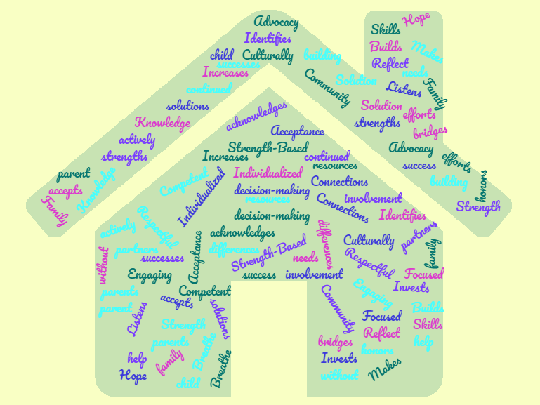
Empowering Resources for Families

Slide 18
Supports and Educational Materials!
Parent Training and Information Centers (PTIs) and Community Parent Resource Centers (CPRCs): | Some websites offering personalized resources and free expert advice | Legal Aid Organizations
https://www.parentcenterhub.org/ https://www.navigatelifetexas.org/en/ Texas Education Agency(TEA), https://tea.texas.gov/ | https://www.wrightslaw.com/ https://www.understood.org/ | TEA Office of General Counsel se-legal@tea.texas.gov

Slide 19
Supports & Materials 2
IEP Meeting Simulations | Family-to-Family Health Information Centers
Some organizations offer simulations or role-play scenarios to help parents practice what an IEP meeting will be like. | Texas Parent to Parent https://www.txp2p.org/services/family-to-family-health-info#:~:text=Texas%20Parent%20to%20Parent%20(TxP2P,or%20special%20health%20care%20needs. Family to Family https://f2fn.org/ https://cdd.tamu.edu/

Slide 20
A quote to remember

Slide 21
Thank You!

