Slide 1
Building Blocks: Strategies for Supporting Special Needs Across the Lifespan
Presented By: Brynn Biggs M.Ed.

Slide 2
Description
In this session, participants will receive resources to support their child with special needs throughout various life stages, spanning from infancy to adulthood. The content encompasses practical checklists, effective best practices, and instructional methods tailored to foster skills in choice and decision-making, goal setting, self-awareness, and self-determination.

Slide 3
What You Will Learn

Slide 4
Choices and Decision Making
Choice and Decision-Making: Gain valuable insights into fostering independence through effective decision-making strategies. Learn how to provide choices that promote self-determination and autonomy.
Goal Setting for Success: Discover goal-setting techniques tailored to the specific needs of your child. Develop a roadmap for setting realistic and achievable milestones, fostering a sense of accomplishment at every stage.

Slide 5
Self-Awareness & Self-Determination
Cultivating Self-Awareness: Delve into methods for promoting self-awareness in children with special needs. Understand the importance of self-understanding and explore activities that encourage emotional intelligence.
Empowering Self-Determination: Uncover strategies for nurturing self-determination in your child. Learn how to instill confidence, resilience, and a sense of empowerment, setting the foundation for a fulfilling and independent adult life.

Slide 6
Birth- Age 3
How early is too early?

Slide 7
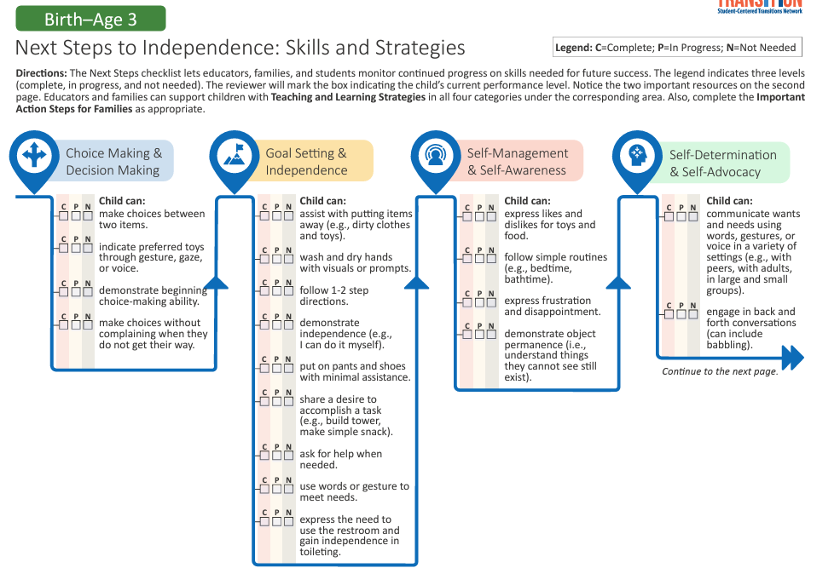
S

Slide 8
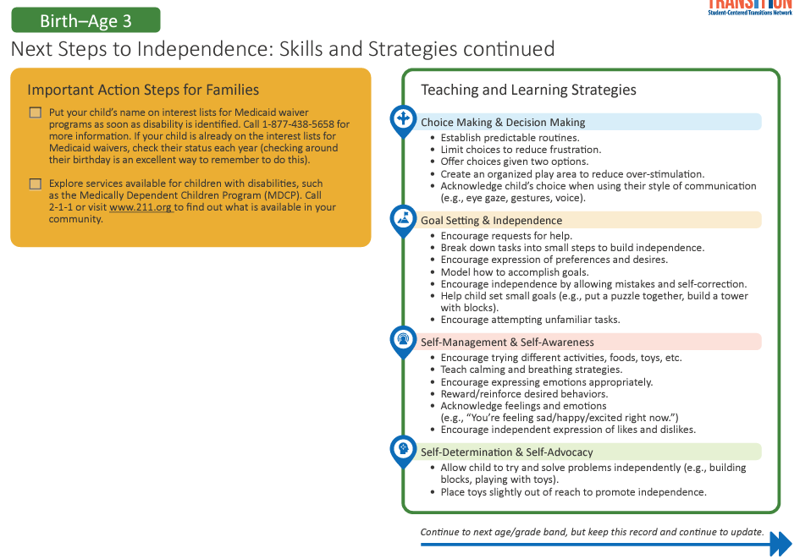
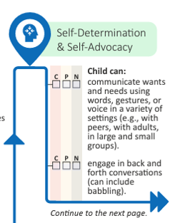
Birth –Age 3 Continued

Slide 9
Age 3-5

Slide 10
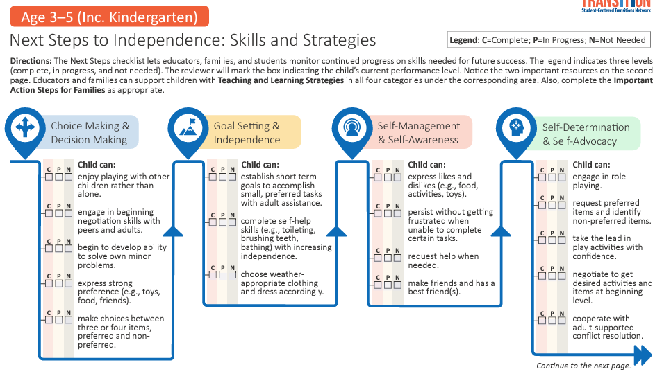
Next step skills & strategies Age 3-5

Slide 11
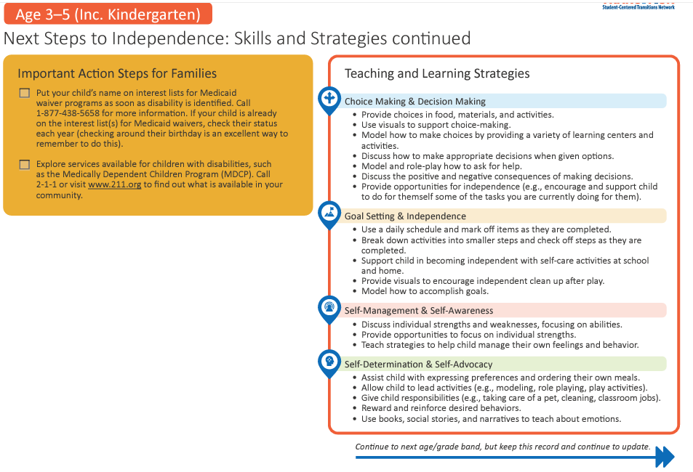
Ages 3-5 Continued

Slide 12
Elementary
School
1st-5th Grade

Slide 13
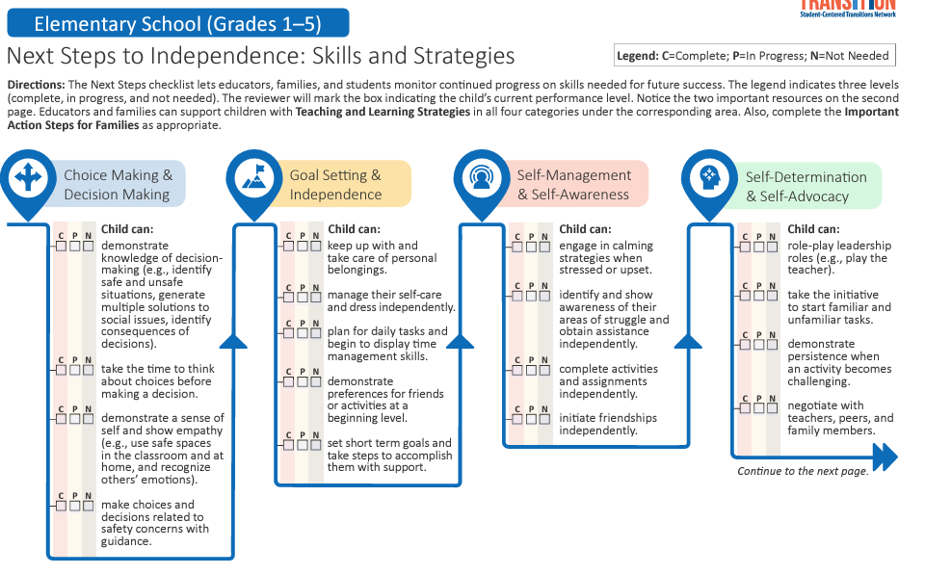
Next Steps Elementary School (grades 1-5)

Slide 14
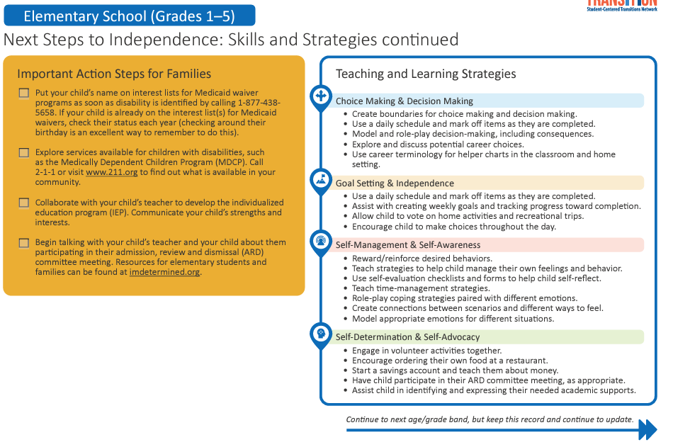
Elementary school (Grades 1-5) continued

Slide 15
Middle School
6th - 8th Grade

Slide 16
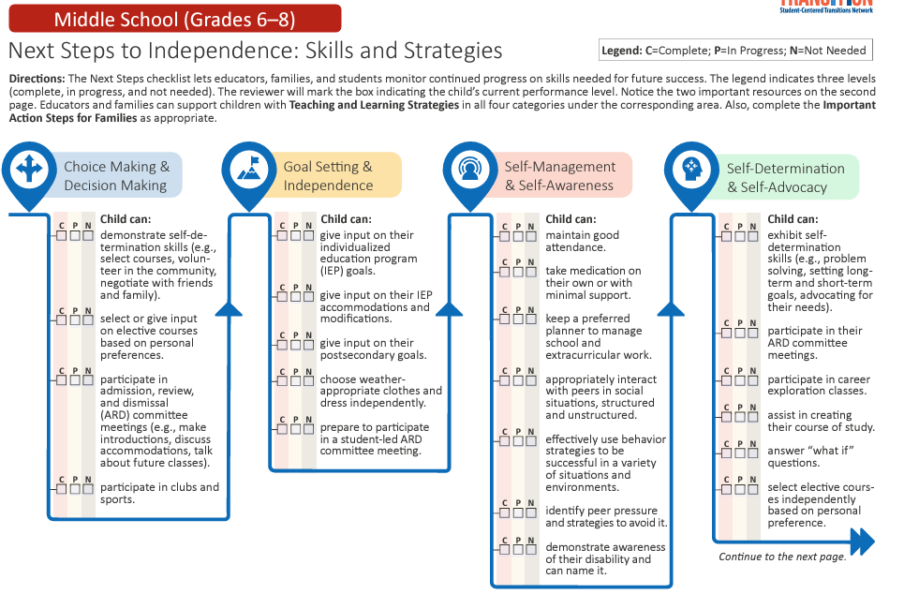
Next steps Middle School Grades 6-8

Slide 17
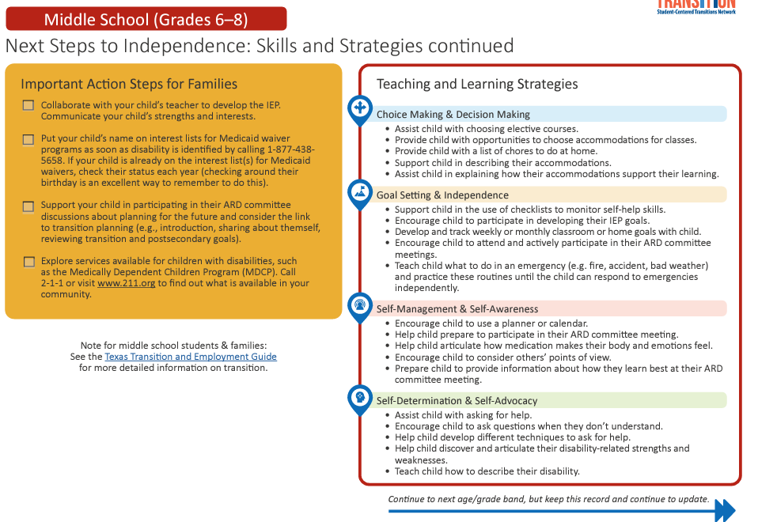
Middle School Grades 6-8 Continued

Slide 18
High School
9th - 12th Grade

Slide 19
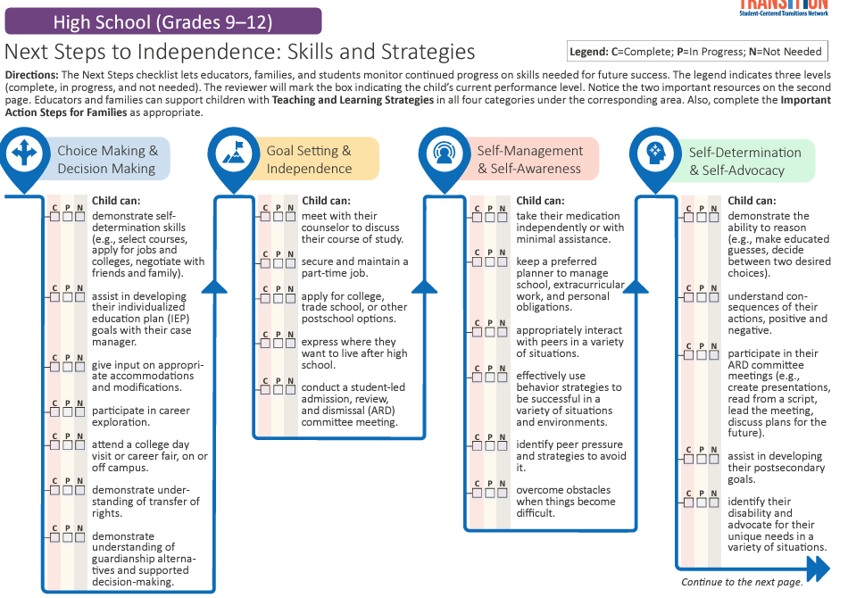
Next steps high school Grades 9-12

Slide 20
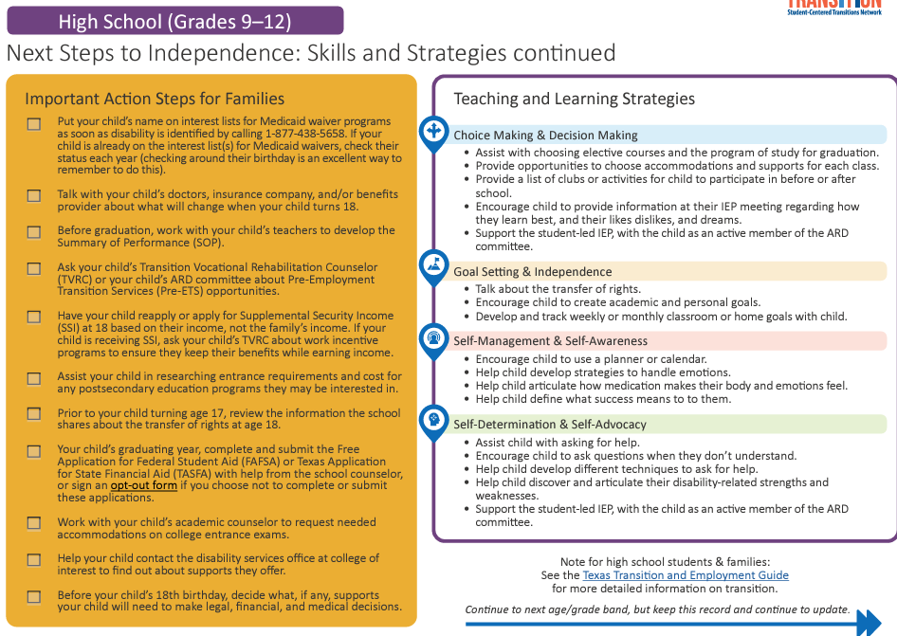
High school Grades 9-12 continued

Slide 21
18+
Ages 18-22

Slide 22
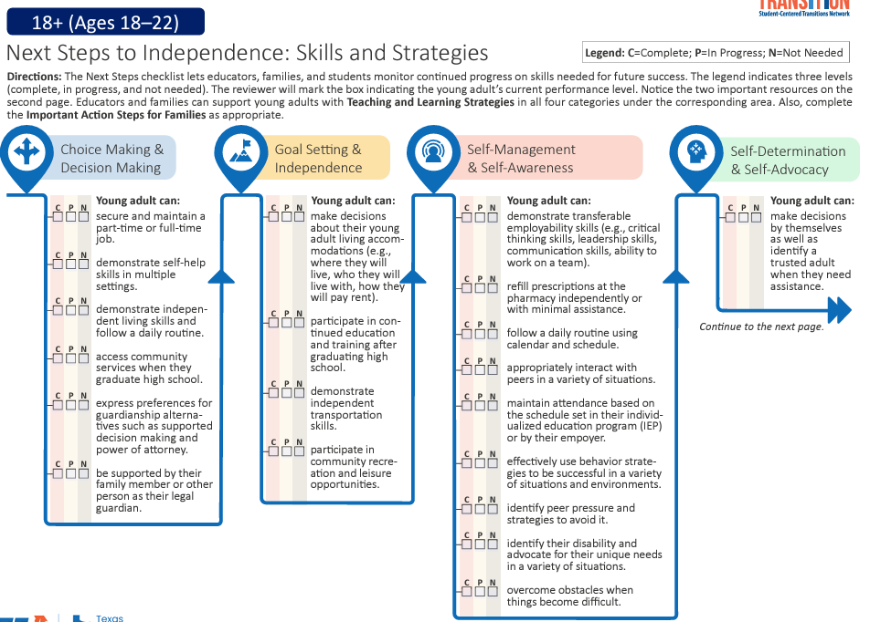
Next steps 18+ (Ages 18-22)

Slide 23
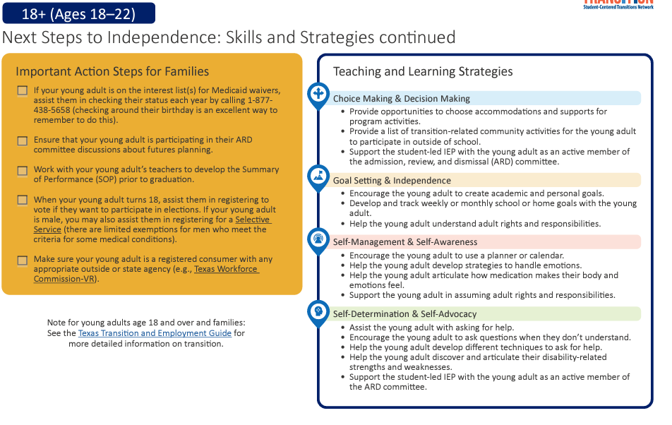
18+ (Ages 18-22) continued

Slide 24
Thank You!
Email:
Brynnbiggs@shsu.edu

